Slide 1
Final Presentation
Natural Language Processing
Code: https://github.com/josefweibel/nlp-medical-project
Rebecka Fahrni, Joseph Weibel

Slide 2
Agenda
Short Recap of Task 2
Recap Goal for Task 3
Dataset Overview
Evaluation Metric of Models
Baseline Models
Applying BERT-like and GPT-like models

Slide 3
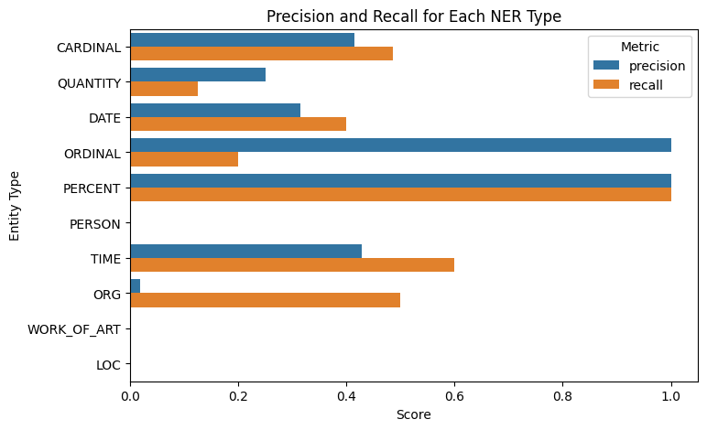
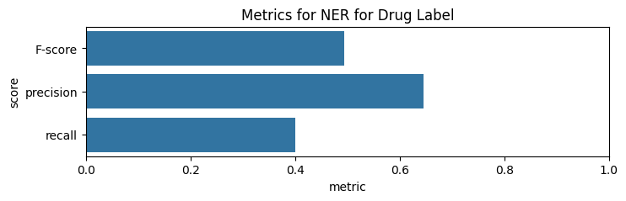
Task 2
Results for default spaCy NER:
Results for own label «drug»:

Slide 4

Recap Goal for Task 3
Classification of medical transcriptions into medical specialties

Slide 5
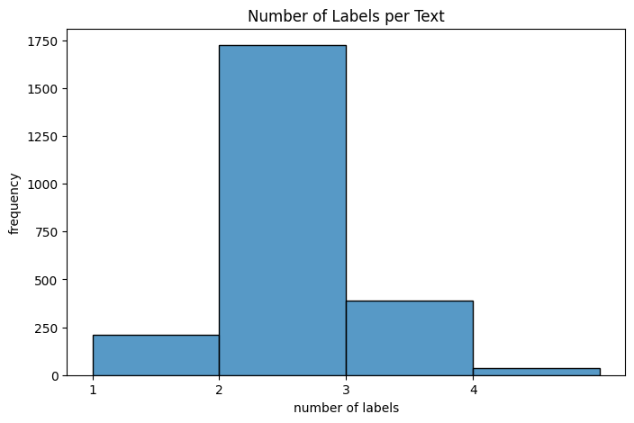
Dataset Overview
Medical transcriptions for various medical specialties
Highly unbalanced dataset
Different text styles: very long text and shorter ones
Letters vs. Autopsy reports
Multi-Label - most text have at least 2 labels
Some classes have only very few samples

Slide 6

Evaluation Strategy
Evaluation of method: 5-fold cross-validation to ensure robust model assessment using iterative stratification.
Comparing advanced models to simpler machine learning models to evaluate improvements.
Accuracy does not provide a complete picture of model performance, especially where class imbalance in the dataset.
Primary Metric: F1-scores, balancing precision and recall for a holistic performance view
Harmonic mean of precision and recall
F1-score crucial for datasets with imbalanced classes.
High F1 score: well-balanced performance
Low F1 score: model trouble striking balance
Precision and Recall for better understanding of the predictions

Slide 7
Baseline Models
Pipeline:
TF-IDF
Pre-processing:
standarize text length (512 tokens)
Lowercasing
Stemming (Snowball) / (Lemmatization – did not apply)
Punctuations, numbers removal
Label preprocessing: filtering out labels with fewer than 25 texts to focus on more significant labels
Balancing dataset (model specific, can‘t be done for every model in a multilabel setting)
Tested: SVM, NB, RF, XGBoost,

Slide 8
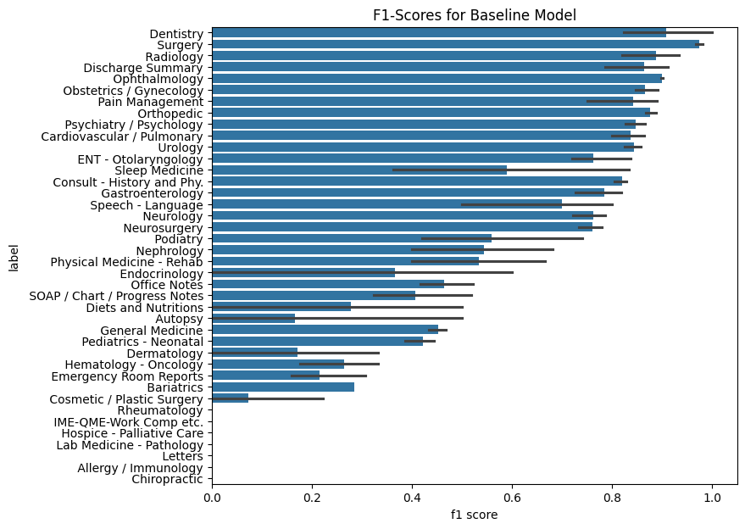
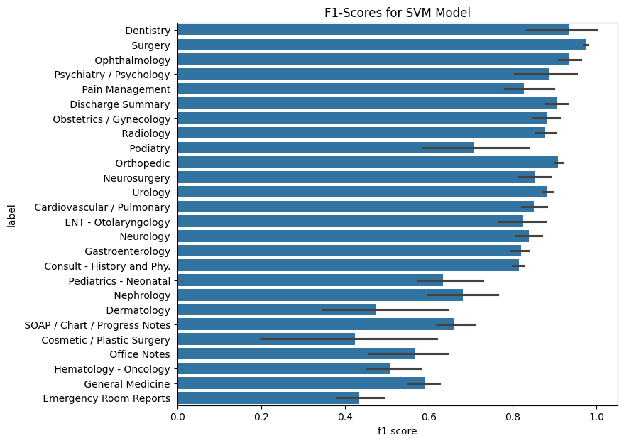
F1-Scores for Baseline Model - sVM
SVM – unbalanced class weights
SVM – balanced class weights (only labels with >25 samples)

Slide 9
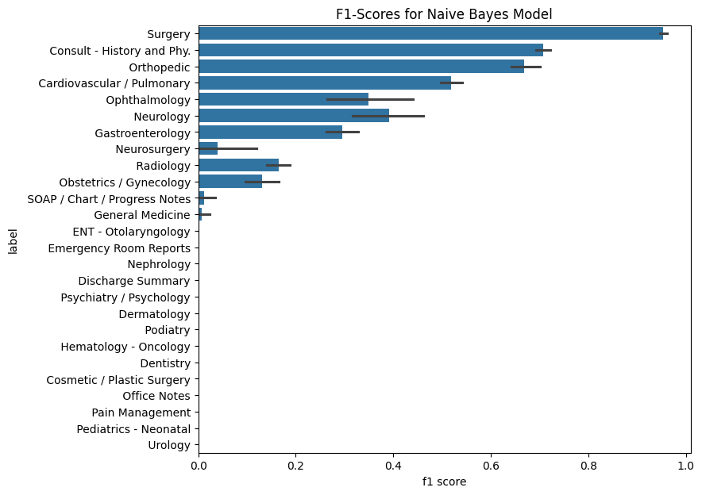
F1-Scores for Baseline Model - Naive Bayes
NB - unbalanced class weights (only labels with >25 samples)
Other models can handle imbalanced data better. Random Forests or Gradient Boosting Machines can be more resilient to class imbalance.

Slide 10
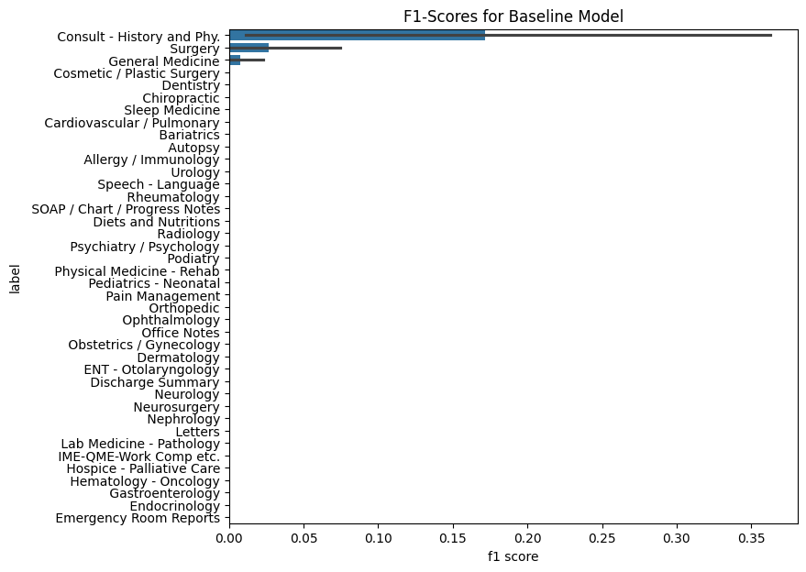
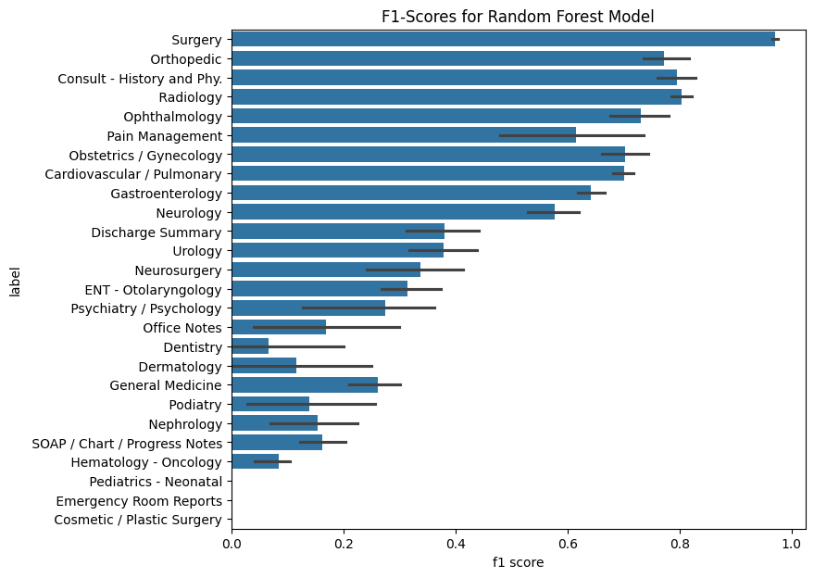
F1-Scores for Baseline Model – Random Forest
RF- unbalanced class weights
RF - balanced class weights (only labels with >25 samples)

Slide 11
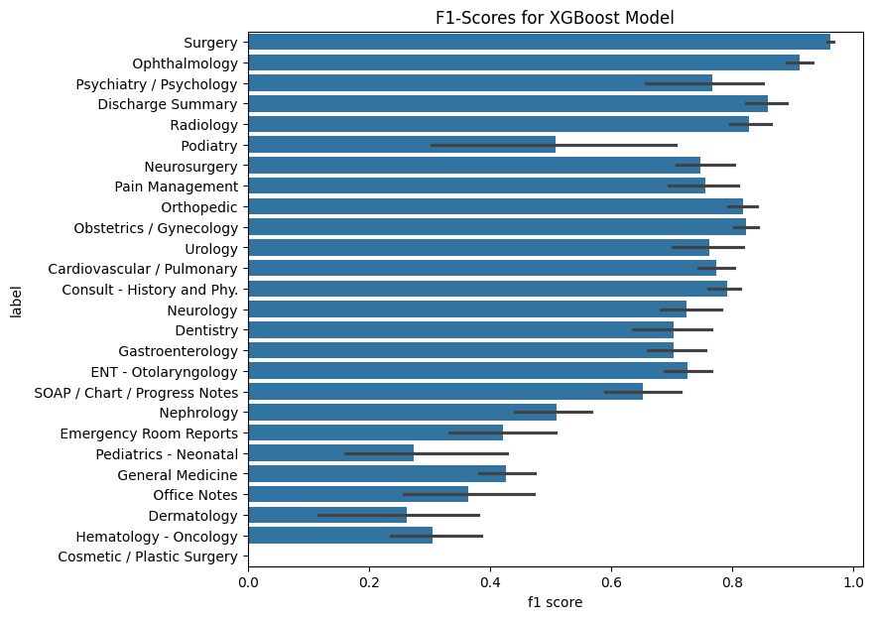
F1-Scores for Baseline Model – XGBoost
XGBoost - unbalanced class (only labels with >25 samples)

Slide 12
Baseline model
Variability in F1 Scores: Variance in F1 scores across different medical categories maybe because data is very diverse or label contain too few samples to generalize
Impact of Class Balance:
Random Forest: balance class weights in Random Forest models has led to a more uniform distribution of F1 scores across categories – positive impact of handling class imbalance for model performance
SVM: Balanced class weights improved performance on several minority classes
NB and XGBoost: These models do not inherently support class weights and show more disparity in performance across categories. NB struggles more with the class imbalance, gradient boost is more robust.
Random Forest is the only classifier predicting all classes

Slide 13
BERT
Using pre-trained language models
Additional linear layer with sigmoid activation function for classification
Classification based on embedding for [CLS] token of last hidden state in BERT model
No preprocessing for BERT
Reducing token length to 256 to reduce compuational complexity
Weighted cross-entropy loss used
BERT Variants:
bert-base-uncased
dmis-lab/biobert-base-cased-v1.2
medicalai/ClinicalBERT (DistilBERT)
epochs=10, weight_decay=0.1, lr=1e-4, batch_size=32

Slide 14
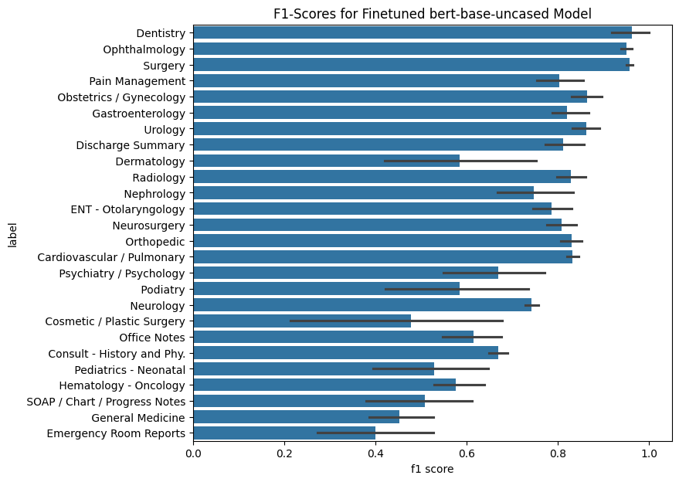
Advanced Models: bert-base-uncased
all classes are predicted
classes with many samples perform better and have lower variance across folds

Slide 15
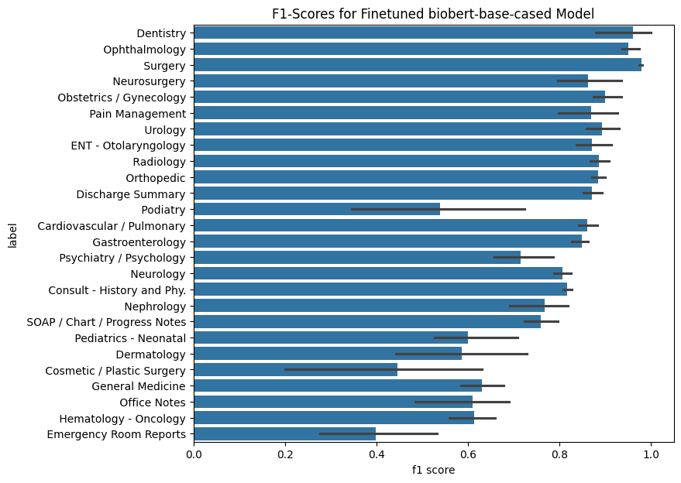
Advanced Models: biobert-base-cased
similar but slightly better results

Slide 16
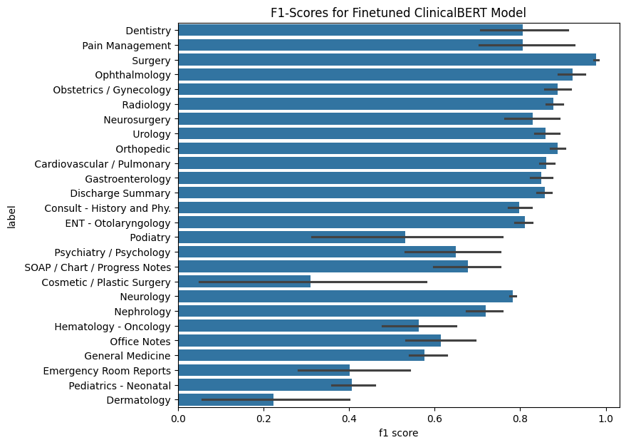
Advanced Models: ClinicalBERT
also similar, but slightly worse results

Slide 17
BERT modelS
Scores for all classes are above 0
Top-Classes Dentistry, Surgery and Ophthalmology perform well on all three models
Surgery is the most common class (1088 samples), however Dentistry has only 27 samples, Ophthalmology has 83 samples
Texts for Dentistry and Ophthalmology might consist of some specific and unique words or token combinations for their subject
Regular bert-base-uncased performs good
Medical adaption BioBERT is slightly better
might be due to refined embeddings for medical vocabulary during pre-training
ClinicalBERT has the lowest metrics of all BERT models
might be due to the lower accuracy of DistilBERT models in general (has fewer parameters than BERT)
In general: BERT models achieve higher scores for classes with fewer samples
might be due to the knowledge existing in the pre-trained models
Uncertainties vary greatly across classes
Quality might improve when using 512 instead of 256 tokens

Slide 18
GPT
Tried different pre-trained Llama 2 variants (without finetuning)
meta-llama/Llama-2-7b-chat-hf
meta-llama/Llama-2-13b-chat-hf
meta-llama/Llama-2-70b-chat-hf
epfl-llm/meditron-7b
TheBloke/meditron-7B-chat-AWQ
mistralai/Mistral-7B-Instruct-v0.2
Asked models whether text belongs to a single class
resulted in 2357*40 prompts
single prompt asking for all 40 classes per text perfomed poorly
Testing different prompts
Zero-Shot
Few-Shot using different text of prompted classes
Set low temperature (0.01) for mostly deterministic responses with few hallucinations
Asking model to answer with yes or no
Determining binary response by counting occurences of yes and no in text reponse by model
Difficulties with some models and prompts
No cross-validation as no training data was needed

Slide 19
zero-Shot Prompt
System: You are a helpful assistant responding to the user's classification requests. Answer in a single word: yes or no.
User: Do you think the following text can be classified as "{category}"? Answer yes or no.
{text}
Assistant:

Slide 20
Few-Shot Prompt with 1 example sample
System: You are a helpful assistant responding to the user's classification requests. Answer in a single word: yes or no.
User: Do you think the following text can be classified as "{category}"? Answer yes or no.
{sample_text}
Assistant: Yes
User: Do you think the following text can be classified as "{category}"? Answer yes or no.
{text}
Assistant:

Slide 21
zero-Shot Prompt For Meditron (Not instruction-finetuned Variant)
Answer in a single word: yes or no. Do you think the following text can be classified as "{category}"? Answer yes or no.
{text}
Answer:

Slide 22
zero-Shot Prompt For Mistral (no system messages)
User: Do you think the following text can be classified as "{category}"? Answer in a single word: yes or no.
{text}
Assistant:

Slide 23
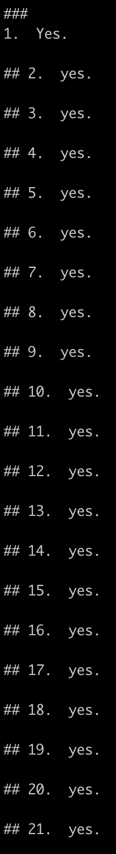
Issues
Llama 2 model with 70B parameters is too large for used infrastructure
could be loaded on four GPUs, but inference took too long (several days for all prompts)
Few-shot prompt has too many tokens and could not be tested
(tried with Llama 2 7B and 13B) inference took too long (several days for all prompts)
Chain-of-Thought prompt could not be tested
inference would have taken too long as well
Mistral model could not be loaded
because of issues with transformers package
Meditron models produced unusable results
we tried multiple prompts
model generated text endlessly and generated many answers for the questions
might first need finetuning on a downstream task
However, zero-shot prompt with Llama 2 7B and 13B did work ☺

Slide 24
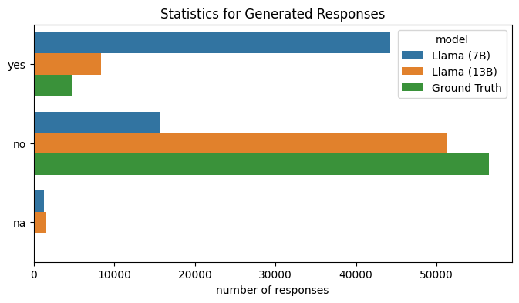
Statistics for generated responses
Most responses (7B: 64%, 13B: 63%) consisted only of either “yes” or “no”
Counting yes and no in response and deciding whether the model predicts yes or no
7B model concludes way more often with yes than 13B model
Both models are more optimistic to yes answers than yes answers exist in the ground truth
only a few responses for which no yes or no could be identified (either because the model did not want to decide or it used different words than yes or no)

Slide 25
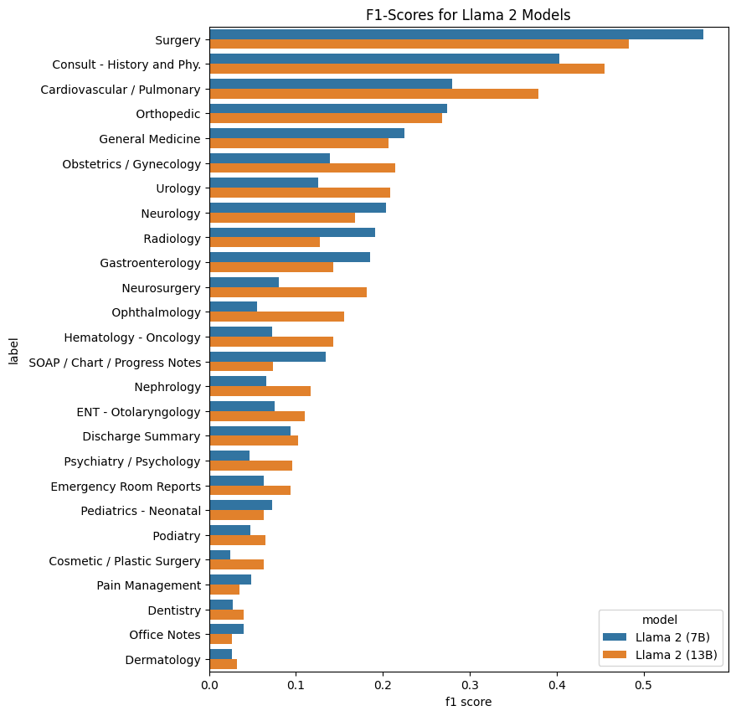
F1-Scores for Llama 2 Models
In general: scores worse than for BERT models (mostly lower than 0.5)
For most classes model with 13B params performs better than with 7B
Many classes perform very poorly with both models

Slide 26
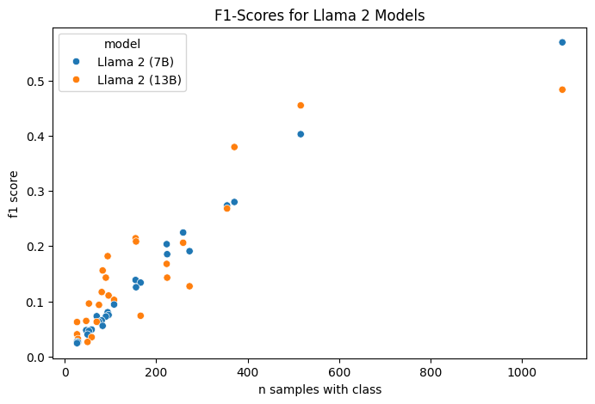
F1-Scores for Llama 2 Models
There seems to be a dependency between number of samples per class and F1-score of both models
More samples result in higher scores
This is interesting as each sample was queries separately and no training with that data happened
As the dataset is public data, the model might have been pre-trained using that data
If Llama 2 is asked whether it knows the argilla/medical-domain dataset, it confirms and lists some characteristics of the dataset
In that case, achieved scores can not be transferred to unseen data

Slide 27
Conclusion
Comparison between baseline, BERT and GPT models
Using precision and recall (decide metric on use case)

Slide 28
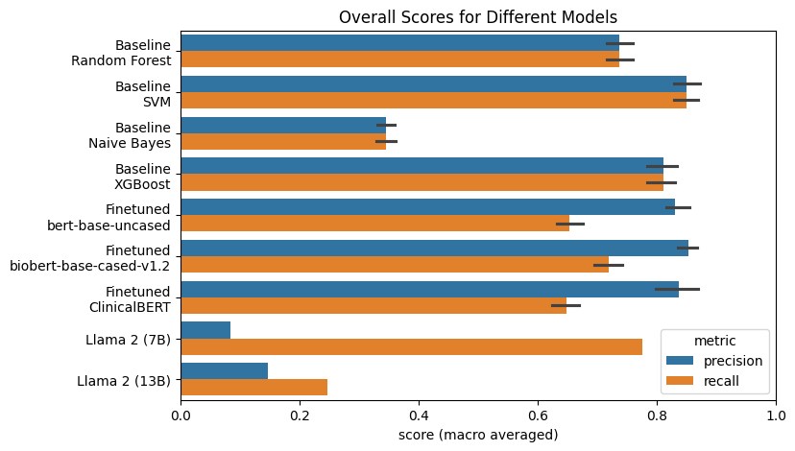
Overall Scores for all Models

Slide 29
Conclusions
Precision and recall are very similar for each baseline model
Seem to have a good balance
Finetuned BERT models perform equally well when comparing precision
Llama 2 models perform worse than all other models, including baseline models.
Finetuning (regularly, LoRA or QLoRA) might improve the results
Few-shot prompt might improve predictions → increases required compuation resources
Recall of Llama 7B is very high; however, recall is very low
Because it mostly predicts yes
Uncertainty between folds is relatively low for all models
SVM model offers a good balance between quality and computational costs
Quality varies greatly between the classes
more training data for underrepresented classes needed

Slide 30
Thank you
Rebecka Fahrni, Joseph Weibel
For Details, see code in Github repositories

